Slide 1

Sir Syed University of Engineering & Technology, Karachi
CS-468 Software Quality Assurance & Testing
Week 1
Session 2

Slide 2
Quality Control & Quality Assurance ...
Quality control is defined as “a set of activities designed to evaluate the quality of a developed or manufactured product” (IEEE, 1991); in other words, activities whose main objective is the withholding of any product that does not qualify. Accordingly, quality control inspection and other activities take place as the development or manufacturing of the product is completed yet before the product is shipped to the client.
The main objective of quality assurance is to minimize the cost of guaranteeing quality by a variety of activities performed throughout the development and manufacturing processes/stages. These activities prevent the causes of errors, and detect and correct them early in the development process. As a result, quality assurance activities substantially reduce the rate of products that do not qualify for shipment and, at the same time, reduce the costs of guaranteeing quality in most cases.

Slide 3
... Quality Control & Quality Assurance
Quality Assurance (QA) | Quality Control (QC)
It is process related. | It is product related.
It focuses on the process used to develop a product. | It focuses on testing of a product .
QA → SQA | QC → tester.

Slide 4
The uniqueness of software quality assurance.
The fundamental differences between software products (including firmware) and other products are caused by the higher product complexity, by the invisibility of software and by the nature of the product development and production process.
These differences create the need for an SQA methodology and tools for SQA that will meet the special and different challenges for the development and operation of quality assurance for software.

Slide 5
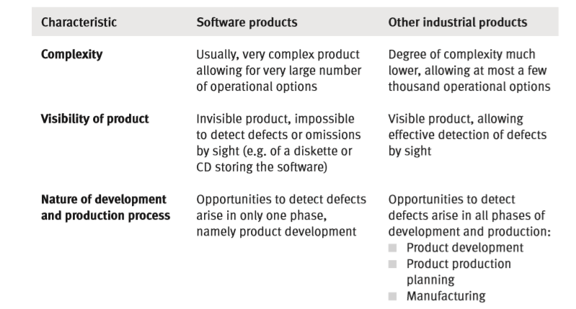
The uniqueness of software quality assurance.

Slide 6
Characteristics for SQA Environments...
The SQA methods and tools for professional software development and maintenance, activities where quality problems appear in their most severe form, and where the most painful losses are expected. Therefore any method or tool to be applied is subject to the environmental characteristics of their activities, namely:
Contract conditions and commitments defining the contents and timetable.
The conditions of the customer–supplier relationship, as realized by the need for consultation with the customer and the acquisition of his approval.
Teamwork requirements.
Need for cooperation and coordination with other software and hardware development teams both internally and externally.
Need for interfaces with other software systems.
Need to continue carrying out a project when team members change.
Need to conduct maintenance of the software system for several years.
These environmental characteristics also apply to internal development of software and firmware, though only informal contract or informal customer–supplier relationships exist in these cases.
These characteristics demand that intensive and continuous managerial efforts be expended in parallel to the professional efforts that have to be invested in order to ensure the project’s quality or, in other words, to assure the project’s success.

Slide 7
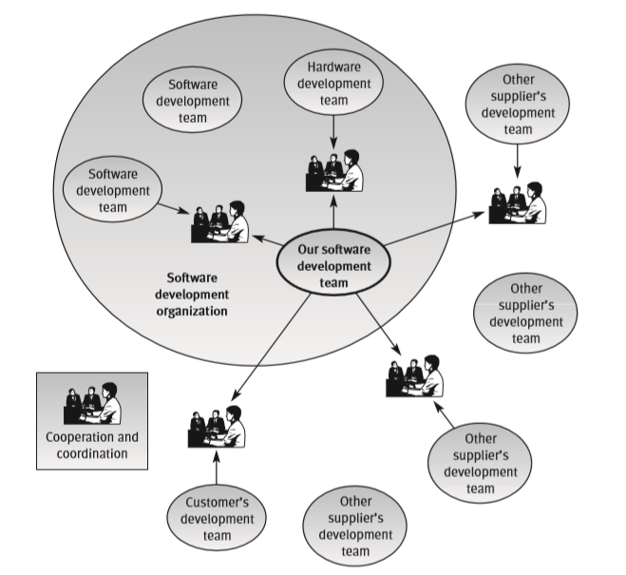
...Characteristics for SQA Environments...

